Slide 1

About the Presentations
The presentations cover the objectives found in the opening of each chapter.
All chapter objectives are listed in the beginning of each presentation.
You may customize the presentations to fit your class needs.
Some figures from the chapters are included. A complete set of images from the book can be found on the Instructor Resources disc.
Guide to Operating Systems, 5th Edition
Notes:
About the Presentations
The presentations cover the objectives found in the opening of each chapter.
All chapter objectives are listed in the beginning of each presentation.
You may customize the presentations to fit your class needs.
Some figures from the chapters are included. A complete set of images from the book can be found on the Instructor Resources disc.

Slide 2
Guide to Operating Systems, 5th Edition
Unit 7
Operating Systems Fundamentals
Notes:
Guide to Operating Systems, 5th Edition
Chapter 1
Operating Systems Fundamentals

Slide 3
Objectives
After completing this chapter, you will be able to:
Explain basic operating system concepts
Understand the history of operating system development
Discuss how operating systems work
Describe the types of operating systems
Discuss single tasking versus multitasking
Guide to Operating Systems, 5th Edition
Notes:
Objectives
After completing this chapter, you will be able to:
Explain basic operating system concepts
Understand the history of operating system development
Discuss how operating systems work
Describe the types of operating systems
Discuss single tasking versus multitasking

Slide 4
Objectives
After completing this chapter, you should will be able to (cont’d):
Differentiate between single-user and multiuser operating systems
List and briefly describe current operating systems
Guide to Operating Systems, 5th Edition
Notes:
Objectives
After completing this chapter, you should be able to (cont’d):
Differentiate between single-user and multiuser operating systems
List and briefly describe current operating systems

Slide 5
An Introduction to Operating Systems
A computer’s functions and features can be broken down into three basic tasks all computers perform:
  Input
  Processing
  Output
Functions above involve some type of computer hardware
  But the hardware is controlled and coordinated by the operating system (OS)
Guide to Operating Systems, 5th Edition
Notes:
An Introduction to Operating Systems
A computer’s functions and features can be broken down into three basic tasks all computers perform:
Input
Processing
Output
Functions above involve some type of computer hardware
But the hardware is controlled and coordinated by the operating system (OS)

Slide 6
An Introduction to Operating Systems
An OS is a specialized computer program that provides the following features:
  User interface – provides a method for users to interact with the computer
  File system – method by which an OS stores and organizes files and manages access to files
  Processes and services – a process is a program that’s loaded into memory and run by the CPU; a service is a type of process that runs in the background
  Kernel – the heart of the OS
Guide to Operating Systems, 5th Edition
Notes:
An Introduction to Operating Systems
An OS is a specialized computer program that provides the following features:
User interface – provides a method for users to interact with the computer
File system – method by which an OS stores and organizes files and manages access to files
Processes and services – a process is a program that’s loaded into memory and run by the CPU; a service is a type of process that runs in the background
Kernel – the heart of the OS

Slide 7
Desktop Versus Server Operating System
Two types of OSs will be covered in this book:
  Desktop operating system (client OS) – installed on a personal computer (PC) that is used by one person at a time, and may be connected to a network
    Examples of installations are desktop computers, laptops, iMac computers, and tablets
  Server operating system – installed on a more powerful computer that is connected to a network and enables multiple users to access information such as e-mail, files, and software
Guide to Operating Systems, 5th Edition
Notes:
Desktop Versus Server Operating System
Two types of OSs will be covered in this book:
Desktop operating system (client OS) – installed on a personal computer (PC) that is used by one person at a time, and may be connected to a network
Examples of installations are desktop computers, laptops, iMac computers, and tablets
Server operating system – installed on a more powerful computer that is connected to a network and enables multiple users to access information such as e-mail, files, and software

Slide 8
Desktop Versus Server Operating System
Traditional server – often used by small or medium businesses
Rack-mounted server – CPU boxes mounted in racks that can hold multiple servers
  All servers often share one monitor & pointing device
Blade servers – looks like a card that fits into a blade enclosure
  A blade enclosure is a large box with slots for blade servers
  Medium and large organizations use blade servers
Guide to Operating Systems, 5th Edition
Notes:
Desktop Versus Server Operating System
Traditional server – often used by small or medium businesses
Rack-mounted server – CPU boxes mounted in racks that can hold multiple servers
All servers often share one monitor & pointing device
Blade servers – looks like a card that fits into a blade enclosure
A blade enclosure is a large box with slots for blade servers
Medium and large organizations use blade servers

Slide 9
Input and Output
A basic task of an OS is to take care of input/output (I/O) functions, which let other programs communicate with the computer hardware
Some examples of I/O tasks:
  Handle input from the keyboard, mouse, and other input devices
  Handle output to the monitor and printer
  Manage network communications, such as for a local network and the Internet
  Control input/output for devices such as network interface card
Guide to Operating Systems, 5th Edition
Notes:
Input and Output
A basic task of an OS is to take care of input/output (I/O) functions, which let other programs communicate with the computer hardware
Some examples of I/O tasks:
Handle input from the keyboard, mouse, and other input devices
Handle output to the monitor and printer
Manage network communications, such as for a local network and the Internet
Control input/output for devices such as network interface card

Slide 10
Input and Output
Some examples of I/O tasks (cont’d):
  Control information storage and retrieval using various types of disk
  Enable multimedia use for voice and video composition or reproduction, such as recording video from a camera or playing music
Guide to Operating Systems, 5th Edition
Notes:
Input and Output
Some examples of I/O tasks (cont’d):
Control information storage and retrieval using various types of disk
Enable multimedia use for voice and video composition or reproduction, such as recording video from a camera or playing music

Slide 11
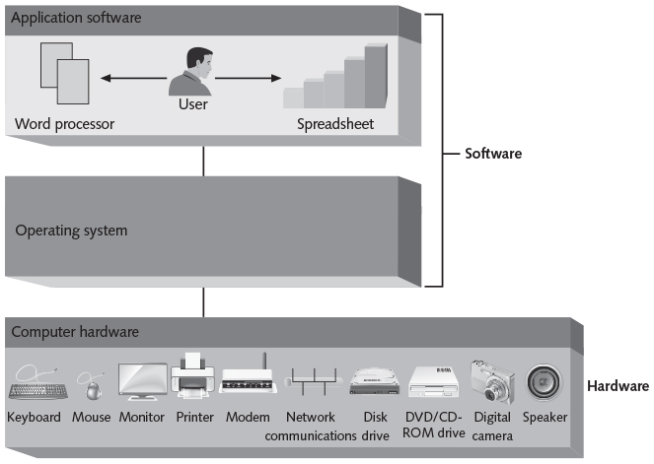
Input and Output
Figure 1-1 General tasks for all operating systems
Guide to Operating Systems, 5th Edition
Notes:
Input and Output

Slide 12
A Short History of Operating Systems
Initially, computers were used as large automated calculators for mathematical and statistical problems
Legitimate use can be traced back 100 years or more but there were no practical designs used by significant numbers of people until the late 1950’s
Operating systems were rudimentary, often not able to do more than read punch cards or tape and write output to machines resembling typewriters
  It did not take long before applications evolved to do something useful for a broader audience
Guide to Operating Systems, 5th Edition
Notes:
A Short History of Operating Systems
Initially, computers were used as large automated calculators for mathematical and statistical problems
Legitimate use can be traced back 100 years or more but there were no practical designs used by significant numbers of people until the late 1950’s
Operating systems were rudimentary, often not able to do more than read punch cards or tape and write output to machines resembling typewriters
It did not take long before applications evolved to do something useful for a broader audience

Slide 13
A Short History of Operating Systems
Computers of the late 60’s and early 70’s were crude by today’s standards but were quite capable
  Contributed to the development of space travel, submarine-based ballistic missiles, and the global financial community
This period saw:
  The beginning of the Internet
  Creation of input and output devices such as display terminals and magnetic disks
  Creation of more operating systems such as OS/8 and UNIX
Guide to Operating Systems, 5th Edition
Notes:
A Short History of Operating Systems
Computers of the late 60’s and early 70’s were crude by today’s standards but were quite capable
Contributed to the development of space travel, submarine-based ballistic missiles, and the global financial community
This period saw:
The beginning of the Internet
Creation of input and output devices such as display terminals and magnetic disks
Creation of more operating systems such as OS/8 and UNIX

Slide 14
A Short History of Operating Systems
In the mid-1960’s, a simple programming language was developed at Dartmouth College
  BASIC – Beginner’s All-purpose Symbolic Instruction Code
In 1975, Bill Gates wrote a compiler (software that turns computer code written by people into code that is understood by computers) for BASIC
  Sold it to a company called Micro Instrumentation Telemetry Systems (MITS) who became the first company to produce a desktop computer
Guide to Operating Systems, 5th Edition
Notes:
A Short History of Operating Systems
In the mid-1960’s, a simple programming language was developed at Dartmouth College
BASIC – Beginner’s All-purpose Symbolic Instruction Code
In 1975, Bill Gates wrote a compiler (software that turns computer code written by people into code that is understood by computers) for BASIC
Sold it to a company called Micro Instrumentation Telemetry Systems (MITS) who became the first company to produce a desktop computer

Slide 15
A Short History of Operating Systems
Bill Gates started a new company called Microsoft which led to the development of Microsoft Disk Operating System or MS-DOS
  MS-DOS was the first widely distributed operating system for microcomputers that had to be loaded from disk or tape
  IBM adopted MS-DOS for its PC
In 1984, Apple Macintosh developed a GUI and mouse pointing device, which allowed users to interact with the OS on a graphical screen
In 1985, Microsoft released Windows, which provided a GUI and many of the same functions as MAC OS
Guide to Operating Systems, 5th Edition
Notes:
A Short History of Operating Systems
Bill Gates started a new company called Microsoft which led to the development of Microsoft Disk Operating System or MS-DOS
MS-DOS was the first widely distributed operating system for microcomputers that had to be loaded from disk or tape
IBM adopted MS-DOS for its PC
In 1984, Apple Macintosh developed a GUI and mouse pointing device, which allowed users to interact with the OS on a graphical screen
In 1985, Microsoft released Windows, which provided a GUI and many of the same functions as MAC OS

Slide 16
Understanding How Operating Systems Work
Elements that enable an operating system to work with a computer include:
  The kernel
  Resource managers
  Device drivers
  Application software
  BIOS
Guide to Operating Systems, 5th Edition
Notes:
Understanding How Operating Systems Work
Elements that enable an operating system to work with a computer include:
The kernel
Resource managers
Device drivers
Application software
BIOS

Slide 17
The Kernel
The kernel consists of the essential program code of the operating system
Key tasks of the OS Kernel:
  Scheduling computer processes
  Managing resources, such as memory and processing time
Jobs performed by the kernel can include:
  Managing interactions with the CPU
  Starting, managing, and scheduling programs that handle I/O activities, including device and networking activities
Guide to Operating Systems, 5th Edition
Notes:
The Kernel
The kernel consists of the essential program code of the operating system
Key tasks of the OS Kernel:
Scheduling computer processes
Managing resources, such as memory and processing time
Jobs performed by the kernel can include:
Managing interactions with the CPU
Starting, managing, and scheduling programs that handle I/O activities, including device and networking activities

Slide 18
The Kernel
Jobs performed by the kernel (cont’d):
  Handling basic computer security
  Managing use of the computer’s memory (RAM)
  Managing priority levels assigned to programs and computer processes
In Windows, the name of the kernel file is ntoskrnl.exe and in MAC OS X, the kernel is called XNU
Guide to Operating Systems, 5th Edition
Notes:
The Kernel
Jobs performed by the kernel (cont’d):
Handling basic computer security
Managing use of the computer’s memory (RAM)
Managing priority levels assigned to programs and computer processes
In Windows, the name of the kernel file is ntoskrnl.exe and in MAC OS X, the kernel is called XNU

Slide 19
Resource Managers
Help ensure memory is used properly and there are no memory conflicts
Manages how programs access the processing capabilities of the CPU
  Example: if there is one CPU and ten programs that want to access the CPU, the OS will give each program a time slice on the CPU
    Each program does a little working during its time slice and then hands the CPU access over to the next program the kernel gives the next program or process CPU access for its time slice
Guide to Operating Systems, 5th Edition
Notes:
Resource Managers
Help ensure memory is used properly and there are no memory conflicts
Manages how programs access the processing capabilities of the CPU
Example: if there is one CPU and ten programs that want to access the CPU, the OS will give each program a time slice on the CPU
Each program does a little working during its time slice and then hands the CPU access over to the next program the kernel gives the next program or process CPU access for its time slice

Slide 20
Device Drivers and the Operating System
A device driver translates computer code to display text on a screen
  Or translates movements of a mouse into action
A separate device driver is usually present for each I/O device
The device driver contains the actual code (instructions) to communicate with the chips on the device
Guide to Operating Systems, 5th Edition
Notes:
Device Drivers and the Operating System
A device driver translates computer code to display text on a screen
Or translates movements of a mouse into action
A separate device driver is usually present for each I/O device
The device driver contains the actual code (instructions) to communicate with the chips on the device

Slide 21
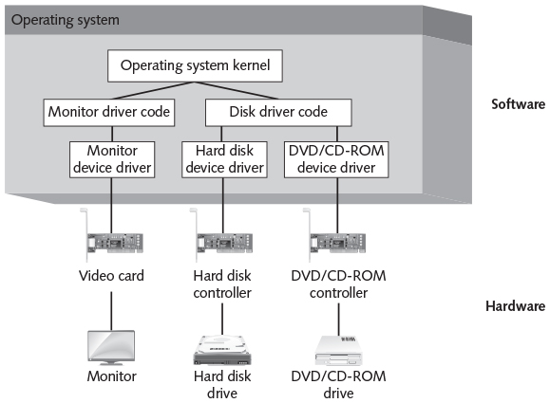
Device Drivers and the Operating System
Figure 1-2 Device drivers provide communication between the OS and hardware devices
Guide to Operating Systems, 5th Edition
Notes:
Device Drivers and the Operating System

Slide 22
The Role of Application Software
Application software
  Any program a user might choose to run on a computer
Examples: word processor, spreadsheet, database, and a computer game
An operating system manages the communication among the applications, the user, and the computer
  Allows application programmers to concentrate on applications that will run on any hardware, as long as the OS can control them
Guide to Operating Systems, 5th Edition
Notes:
The Role of Application Software
Application software
Any program a user might choose to run on a computer
Examples: word processor, spreadsheet, database, and a computer game
An operating system manages the communication among the applications, the user, and the computer
Allows application programmers to concentrate on applications that will run on any hardware, as long as the OS can control them

Slide 23
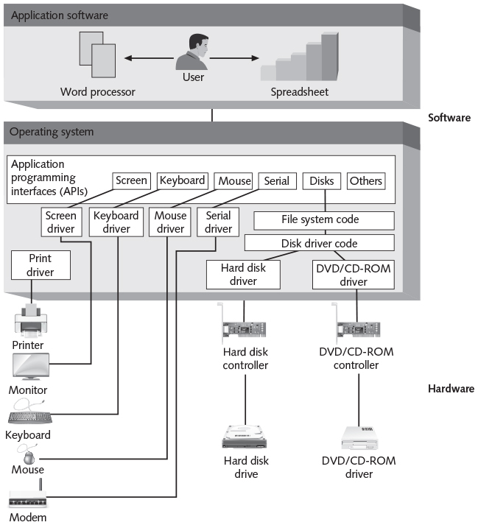
The Role of Application Software
Figure 1-3 Application programs communicate with hardware through the operating system
Guide to Operating Systems, 5th Edition
Notes:
The Role of Application Software

Slide 24
The Role of the BIOS
BIOS – basic input/output system
A low-level program code that:
  Resides on a chip on the computer’s motherboard
  Initiates/enables communications with hardware devices
  Performs tests at startup called power-on self test (POST)
  Conducts basic hardware and software communications inside the computer
  Starts a full-fledged operating system that interfaces with the user
Guide to Operating Systems, 5th Edition
Notes:
The Role of the BIOS
BIOS – basic input/output system
A low-level program code that:
Resides on a chip on the computer’s motherboard
Initiates/enables communications with hardware devices
Performs tests at startup called power-on self test (POST)
Conducts basic hardware and software communications inside the computer
Starts a full-fledged operating system that interfaces with the user

Slide 25
The Role of the BIOS
Every PC has a BIOS, which is stored in a flash memory chip
  Flash memory does not lose its contents when the computer is turned off
BIOS is stored in a complementary metal oxide semiconductor (CMOS) memory chip
When a PC is turned on:
  Runs a startup program inside the BIOS
  Program initializes the screen and keyboard, tests hardware, initializes the hard disk and other drives
  Loads the main operating system onto the hard disk
Guide to Operating Systems, 5th Edition
Notes:
The Role of the BIOS
Every PC has a BIOS, which is stored in a flash memory chip
Flash memory does not lose its contents when the computer is turned off
BIOS is stored in a complementary metal oxide semiconductor (CMOS) memory chip
When a PC is turned on:
Runs a startup program inside the BIOS
Program initializes the screen and keyboard, tests hardware, initializes the hard disk and other drives
Loads the main operating system onto the hard disk

Slide 26
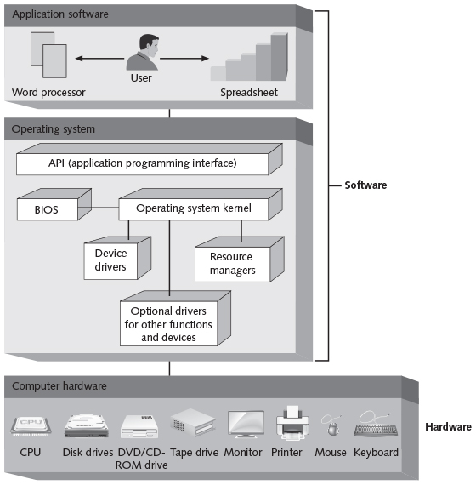
A Summary of Operating System Elements
Figure 1-5 General operating system design
Guide to Operating Systems, 5th Edition
Notes:
A Summary of Operating System Elements

Slide 27
Types of Operating Systems
Operating systems are organized by the size, type, and purpose of the computer on which they run
  Example: PC-class computers are designed for individual users to perform tasks, such as word processing, spreadsheet management, and networking with other computers
Early operating systems were written for large, refrigerator-sized machines and were quite complex
  Applications were written with efficient code and appearance was very basic
Guide to Operating Systems, 5th Edition
Notes:
Types of Operating Systems
Operating systems are organized by the size, type, and purpose of the computer on which they run
Example: PC-class computers are designed for individual users to perform tasks, such as word processing, spreadsheet management, and networking with other computers
Early operating systems were written for large, refrigerator-sized machines and were quite complex
Applications were written with efficient code and appearance was very basic

Slide 28
Types of Operating Systems
Today, “big” machines no longer refer to size
  Refers to more processing power, more memory, more storage, and better network connectivity
To operate today’s more powerful computers, more powerful and more capable operating systems are needed.
Today’s operating systems must support:
  Multitasking
  High-speed network applications
  More powerful I/O capabilities
Guide to Operating Systems, 5th Edition
Notes:
Types of Operating Systems
Today, “big” machines no longer refer to size
Refers to more processing power, more memory, more storage, and better network connectivity
To operate today’s more powerful computers, more powerful and more capable operating systems are needed.
Today’s operating systems must support:
Multitasking
High-speed network applications
More powerful I/O capabilities

Slide 29
Types of Operating Systems
Factors that differentiate high-end and low-end computers:
  Speed of disk controller, size and speed of the hard disk, amount and speed of memory, size of data pathways, or speed and number of CPUs
Computers and operating systems can be looked at in terms of one or more of the following characteristics:
  Time sharing
  Real time
  Multiuser
Guide to Operating Systems, 5th Edition
Notes:
Types of Operating Systems
Factors that differentiate high-end and low-end computers:
Speed of disk controller, size and speed of the hard disk, amount and speed of memory, size of data pathways, or speed and number of CPUs
Computers and operating systems can be looked at in terms of one or more of the following characteristics:
Time sharing
Real time
Multiuser

Slide 30
Time Sharing
A time-sharing system is a central computer system that is used by multiple users and applications simultaneously
  Mainframe computers are an example
  Used to perform massive calculations or manipulate huge amounts of data (batch processing)
    Example: clearing two million checks and updating their associated bank accounts in batches
  Sequential processing: used by smaller computers where each process request is completed, and the data returned before the next process is started
Guide to Operating Systems, 5th Edition
Notes:
Time Sharing
A time-sharing system is a central computer system that is used by multiple users and applications simultaneously
Mainframe computers are an example
Used to perform massive calculations or manipulate huge amounts of data (batch processing)
Example: clearing two million checks and updating their associated bank accounts in batches
Sequential processing: used by smaller computers where each process request is completed, and the data returned before the next process is started

Slide 31
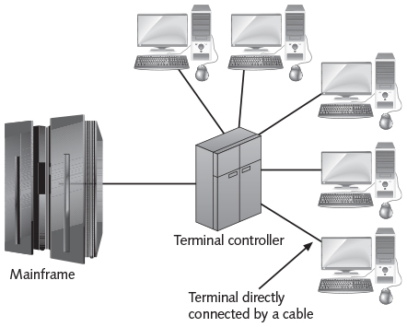
Time Sharing
Figure 1-6 Time-sharing mainframe with terminals
Guide to Operating Systems, 5th Edition
Notes:
Time Sharing

Slide 32
Real-Time Systems
A real-time operating system (ROTS) receives and processes inputs and produces the required outputs in a specified amount of time
  Example: might be used in an industrial plant to control machinery
  More important for the response time of an RTOS to be consistent than fast
These OSs are typically used in embedded systems
  Computer has a dedicated function within a larger system
Guide to Operating Systems, 5th Edition
Notes:
Real-Time Systems
A real-time operating system (ROTS) receives and processes inputs and produces the required outputs in a specified amount of time
Example: might be used in an industrial plant to control machinery
More important for the response time of an RTOS to be consistent than fast
These OSs are typically used in embedded systems
Computer has a dedicated function within a larger system

Slide 33
Multiuser Systems
A multiuser system supports multiple users who access the hardware and software of the computer and operating system
  Both time-sharing and real-time systems can be multiuser
Client/server systems – only some of the work is done on the central computer (server)
  Most of the work is performed on the client side
Client/server computing was not possible until the PC was introduced
Guide to Operating Systems, 5th Edition
Notes:
Multiuser Systems
A multiuser system supports multiple users who access the hardware and software of the computer and operating system
Both time-sharing and real-time systems can be multiuser
Client/server systems – only some of the work is done on the central computer (server)
Most of the work is performed on the client side
Client/server computing was not possible until the PC was introduced

Slide 34
Multiuser Systems
Cloud computing: providing scalable Web-based applications and services over the Internet that are used by clients through Web browsers
Microsoft describes three types of cloud models:
  Private cloud – computing resources are kept within an organization
  Hosted private cloud – resources are made available through a third-party outsourcer
  Public cloud – a variety of resources are available to any organization through a third party
Guide to Operating Systems, 5th Edition
Notes:
Multiuser Systems
Cloud computing: providing scalable Web-based applications and services over the Internet that are used by clients through Web browsers
Microsoft describes three types of cloud models:
Private cloud – computing resources are kept within an organization
Hosted private cloud – resources are made available through a third-party outsourcer
Public cloud – a variety of resources are available to any organization through a third party

Slide 35
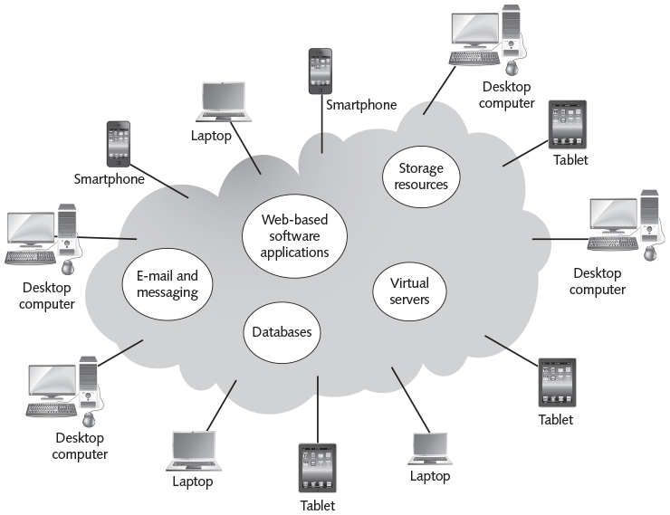
Multiuser Systems
Figure 1-8 Cloud computing
Guide to Operating Systems, 5th Edition
Notes:
Multiuser Systems

Slide 36
Single Tasking Versus Multitasking
Earlier versions of OSs allowed programs to directly access hardware
  More prone to unexpected hangs, system instability, or crashes
Today’s OSs manage access to hardware
  Major reason for this was to facilitate multitasking (running two or more programs at the same time)
Two general types of multitasking:
  Cooperative multitasking
  Preemptive multitasking
Guide to Operating Systems, 5th Edition
Notes:
Single Tasking Versus Multitasking
Earlier versions of OSs allowed programs to directly access hardware
More prone to unexpected hangs, system instability, or crashes
Today’s OSs manage access to hardware
Major reason for this was to facilitate multitasking (running two or more programs at the same time)
Two general types of multitasking:
Cooperative multitasking
Preemptive multitasking

Slide 37
Single Tasking Versus Multitasking
Cooperative multitasking – the OS hands over control to a program and then waits for the program to hand control back to OS
  If program does not give control back to OS, it may hog the CPU until its operations are complete
  No other program can run until control is given back to OS
  Found in early Windows versions
  Example: If you print a word-processing file and try to play Solitaire, you cannot play a card until the print job is finished
Guide to Operating Systems, 5th Edition
Notes:
Single Tasking Versus Multitasking
Cooperative multitasking – the OS hands over control to a program and then waits for the program to hand control back to OS
If program does not give control back to OS, it may hog the CPU until its operations are complete
No other program can run until control is given back to OS
Found in early Windows versions
Example: If you print a word-processing file and try to play Solitaire, you cannot play a card until the print job is finished

Slide 38
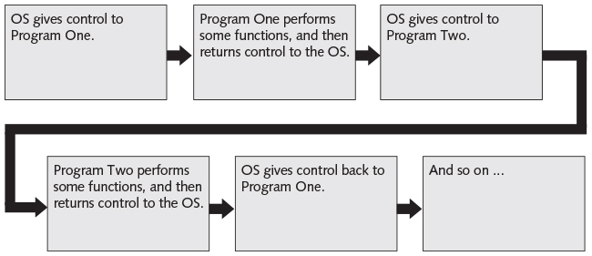
Single Tasking Versus Multitasking
Figure 1-9 Cooperative multitasking basics
Guide to Operating Systems, 5th Edition
Notes:
Single Tasking Versus Multitasking

Slide 39
Single Tasking Versus Multitasking
Preemptive multitasking – the OS is in control of the computer at all times
  Lets programs execute a little of code at a time then forces the program to relinquish control of the CPU
  OS has control over how much of the computer’s resources are allocated to each program
  Computers must use more of its CPU and memory to support the OS, but the behavior of the computer is more predictable
  You could play Solitaire while printing a word-processing file
Guide to Operating Systems, 5th Edition
Notes:
Single Tasking Versus Multitasking
Preemptive multitasking – the OS is in control of the computer at all times
Lets programs execute a little of code at a time then forces the program to relinquish control of the CPU
OS has control over how much of the computer’s resources are allocated to each program
Computers must use more of its CPU and memory to support the OS, but the behavior of the computer is more predictable
You could play Solitaire while printing a word-processing file

Slide 40
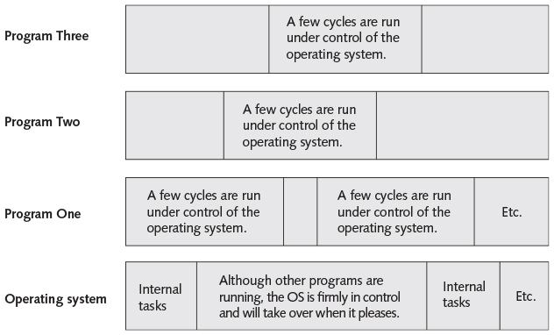
Single Tasking Versus Multitasking
Figure 1-10 Preemptive multitasking basics
Guide to Operating Systems, 5th Edition
Notes:
Single Tasking Versus Multitasking

Slide 41
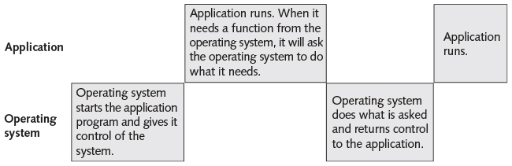
Single Tasking Versus Multitasking
Single-tasking operating systems – execute one program at a time
  To do something else, one program must be stopped
  Older OSs like MS-DOS were single-tasking
Figure 1-11 Single-tasking operating systems
Guide to Operating Systems, 5th Edition
Notes:
Single Tasking Versus Multitasking
Single-tasking operating systems – execute one program at a time
To do something else, one program must be stopped
Older OSs like MS-DOS were single-tasking

Slide 42
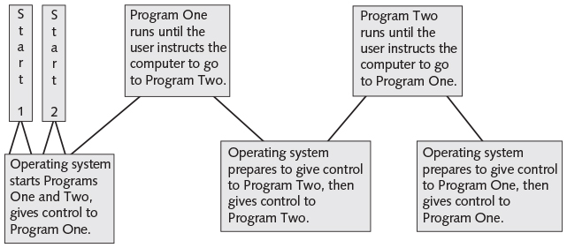
Single Tasking Versus Multitasking
Task-switching operating systems – more than one program can run at a time but only one program can have control at a time
  Earlier versions of Mac OS were task-switching
Figure 1-12 Task switching
Guide to Operating Systems, 5th Edition
Notes:
Single Tasking Versus Multitasking
Task-switching operating systems – more than one program can run at a time but only one program can have control at a time
Earlier versions of Mac OS were task-switching

Slide 43
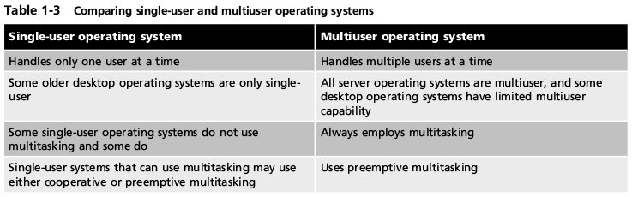
Single-User Versus Multiuser Operating Systems
Table 1-3 Comparing single-user and multiuser operating systems
Guide to Operating Systems, 5th Edition
Notes:
Single-User Versus Multiuser Operating Systems

Slide 44
Current Operating Systems
OS covered in this book:
  Windows 7, 8.1, and 10
  Windows Server 2008, 2012, and 2016
  UNIX/Linux distributions
  Apple Macintosh MAC OS X (version 10.11 El Capitan)
Chapter 2 covers these OSs in more detail
Guide to Operating Systems, 5th Edition
Notes:
Current Operating Systems
OS covered in this book:
Windows 7, 8.1, and 10
Windows Server 2008, 2012, and 2016
UNIX/Linux distributions
Apple Macintosh MAC OS X (version 10.11 El Capitan)
Chapter 2 covers these OSs in more detail

Slide 45
Summary
All computers perform three basic tasks: input, processing, and output
An operating system provides the foundation upon which to run the components of a computer and execute applications
A basic task of an operating system is to enable a computer to perform I/O functions
Two common types of operating systems are desktop and server operating systems
Guide to Operating Systems, 5th Edition
Notes:
Summary
All computers perform three basic tasks: input, processing, and output
An operating system provides the foundation upon which to run the components of a computer and execute applications
A basic task of an operating system is to enable a computer to perform I/O functions
Two common types of operating systems are desktop and server operating systems

Slide 46
Summary
The history of operating systems and computers represents a progression from huge computers to large computers to desktop-sized computers that have powerful operating systems
Device drivers can extend the native function of an operating system to provide access and control over different types of devices
The BIOS is a low-level program code that operates between the computer hardware and an operating system to initiate communication with hardware devices
Guide to Operating Systems, 5th Edition
Notes:
Summary
The history of operating systems and computers represents a progression from huge computers to large computers to desktop-sized computers that have powerful operating systems
Device drivers can extend the native function of an operating system to provide access and control over different types of devices
The BIOS is a low-level program code that operates between the computer hardware and an operating system to initiate communication with hardware devices

Slide 47
Summary
An OS may be geared to run a large mainframe or a small PC-type of computer
OSs can be understood in terms of characteristics such as time sharing, real-time operation, and multiuser capabilities
One of the most significant advances in operating systems is the refinement of the GUI in Windows-based and Mac OS systems
Early OSs tended to be single-tasking, but modern systems are largely multitasking
Guide to Operating Systems, 5th Edition
Notes:
Summary
An OS may be geared to run a large mainframe or a small PC-type of computer
OSs can be understood in terms of characteristics such as time sharing, real-time operation, and multiuser capabilities
One of the most significant advances in operating systems is the refinement of the GUI in Windows-based and Mac OS systems
Early OSs tended to be single-tasking, but modern systems are largely multitasking

Slide 48
Summary
A true multiuser system is one in which multiple users access and run a single application on a single computer at the same time
Currently popular OSs are the topic of this book and include Windows 7, 8.1, and 10, Server 2008/R2, Server 2012/R2, Server 2016, UNIX/Linux, and Mac OS X El Capitan
Guide to Operating Systems, 5th Edition
Notes:
Summary
A true multiuser system is one in which multiple users access and run a single application on a single computer at the same time
Currently popular OSs are the topic of this book and include Windows 7, 8.1, and 10, Server 2008/R2, Server 2012/R2, Server 2016, UNIX/Linux, and Mac OS X El Capitan

